Slide 1
Pre-Diabetes Modelling
Hype-Predictive Modelling

Slide 2
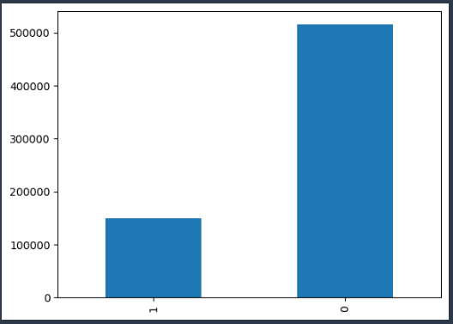
Data Description
Shape of Data: Rows-611343, Column-71 (Including Target)
Event Rate –
Class 0: 76.9
Class 1: 23.1
Train-Test Split (80-20%)
Train Set: 489074,71
Test Set: 122269,71
Final Data after removing negative rows and One-Hot Encoding:
Train Set: 456908,91
Test Set: 114269,91

Slide 3
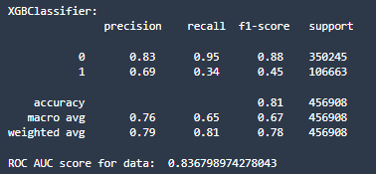
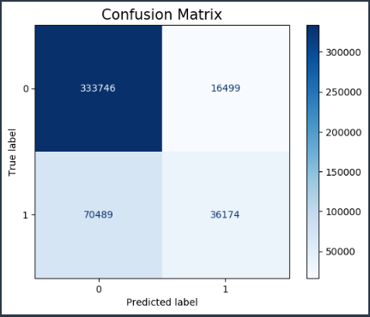
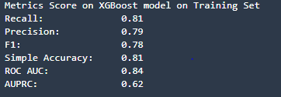
Metrics on Train Set

Slide 4
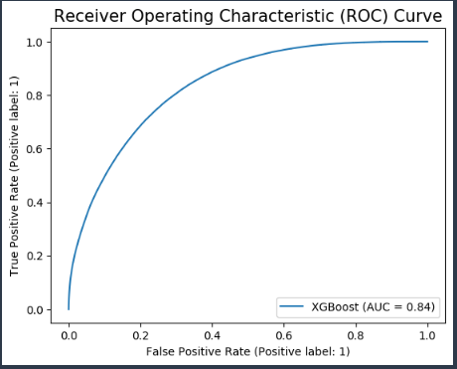
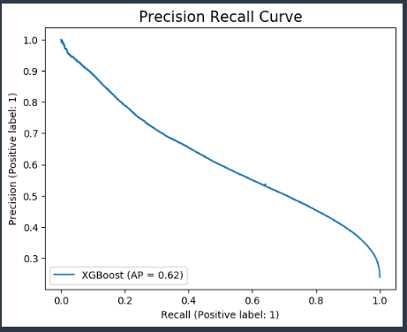

Slide 5
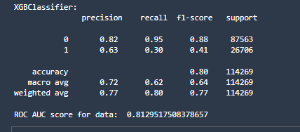
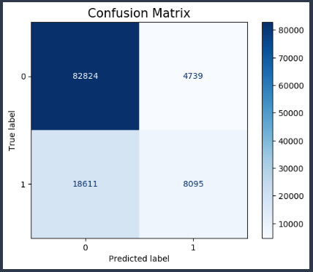
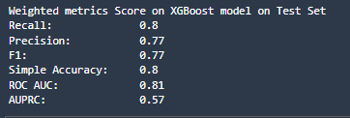
Metrics of Test Set

Slide 6
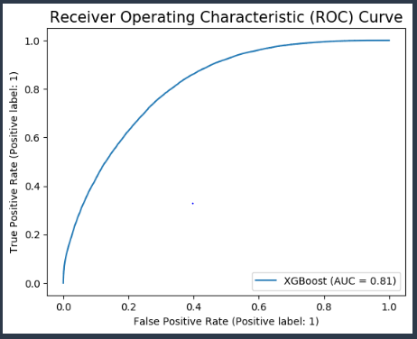
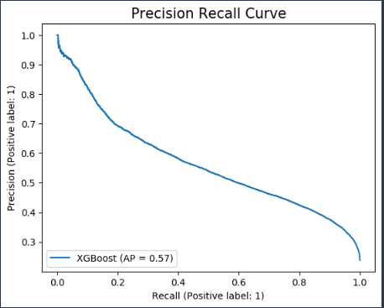

Slide 7
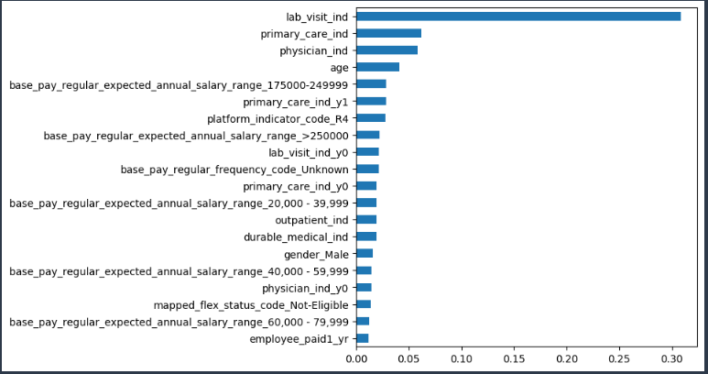
Features Importance from XGBoost Model with default parameters

Slide 8
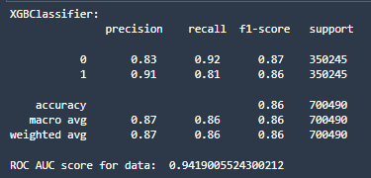
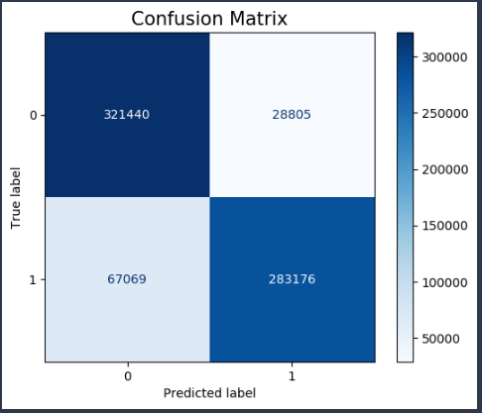
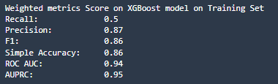
Metrics for train set after applying SMOTE
Shape of Train Set: Rows-700490, Columns-90

Slide 9
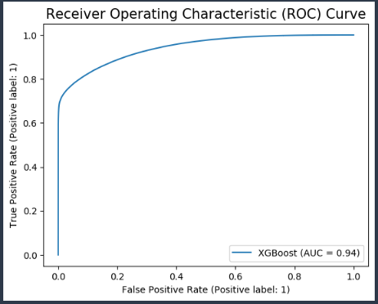
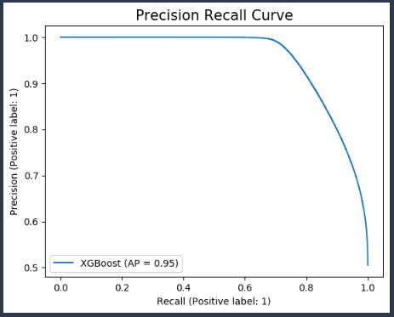
Metrics for train set after applying SMOTE

Slide 10
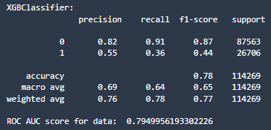
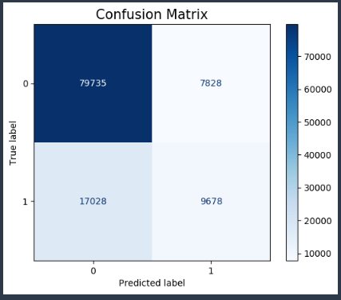
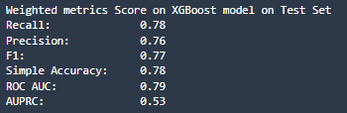
Metrics for test set after applying SMOTE on train set

Slide 11
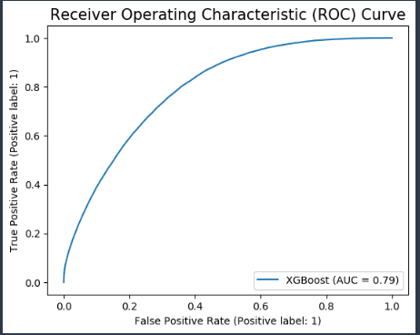
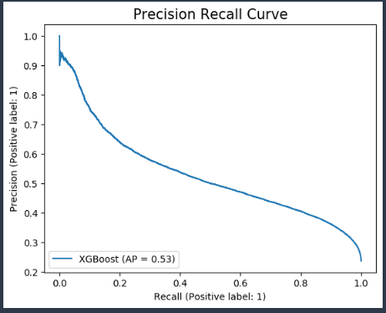
Metrics for test set after applying SMOTE on train set

